Slide 1
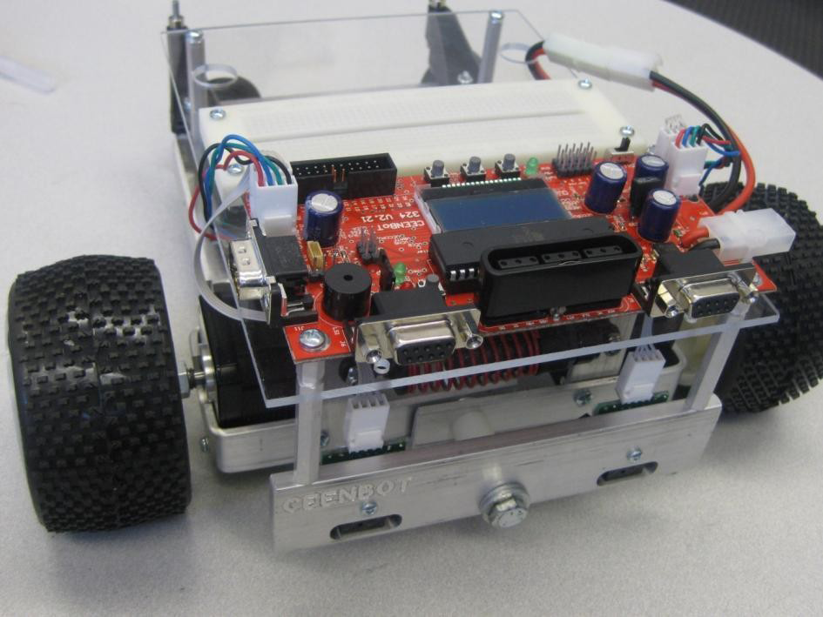
Mobile Robotics Lab
Lab 1: Introduction to the
CEENBoT™
9/9/2010
Fall 2010
Alisa N. Gilmore, P.E., Instructor
Jose Santos, T.A.

Slide 2
Lab 1: Introduction to the CEENBot™
Lab 1 Objectives:
  1. Assemble your CEENBoT™. This is an individual exercise – each person will have their own robot.
  2. Introduction to the CEENBoT™ Application Programming Interface (API).
Pre-Lab 2 Assignment:
  Due Wednesday, 9/15/10.
  Work through the Getting Started manual of the CEENBoT API in its entirety. You can find it at:
    http://ceenbot.digital-brain.info/

Slide 3
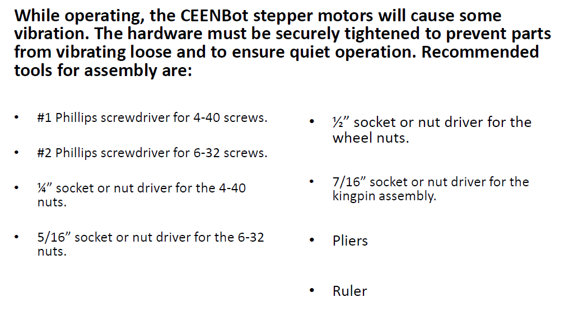
Tools for assembly
A 6-in-1 screwdriver works well. Available at Menards for $1.

Slide 4
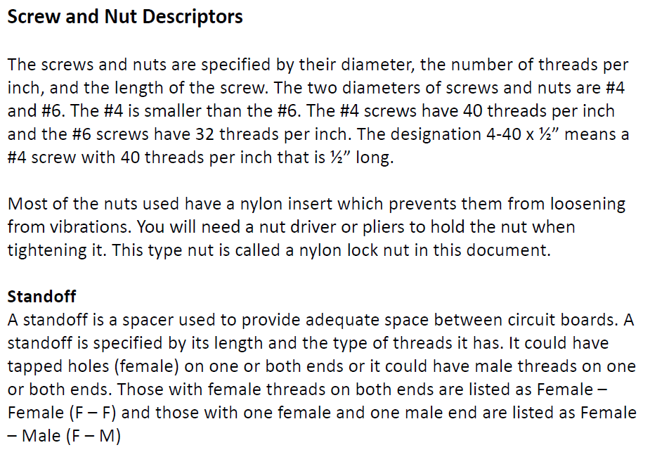
Some descriptions

Slide 5

Ceenbot™ chassis Assembly
Go to CEEN website: http://www.ceen.unomaha.edu/
Under CEEN Quick Links on the right hand side of the page, click on:
CEENBoT / TekBot Site
Once here, click on:
Under:
  Look under: V. 324 Only.
  Click on: Phase 2: Chassis Lab [Interactive] (324 only)

Slide 6
Completed ceenbot™

